Slide 1
Data Mining and Machine Learning Project
Dr. Chang Xiao
Presented by:
Sameeruddin Mohammed

Slide 2
Outline:
Introduction
Dataset Overview
Data Preprocessing
Classifiers
Evaluation
Conclusion

Slide 3
Introduction
Dataset : vote.arff
Project Objective:
The objective of this project is to classify the political party affiliation (Democrat or Republican) of U.S. congresspersons based on their voting behavior on key issues.
I have used machine learning classifiers to analyze voting patterns and classify congresspersons as either Democrats or Republicans.
The project aims to demonstrate how data mining and machine learning can be used to make predictions based on historical voting records.

Slide 4
Dataset Overview: vote.arff
This dataset contains voting records of 435 U.S congresspersons on 16 key issues.
Target Variable: The Class column represents the political party (Democrat and Republican
Key points:
Number of instances: 435
Number of Attributes: 16 + 1(Target Variable)
Data type: Categorical voting data (Yes/No)
Missing values: Some voting records have missing values denoted by (?)

Slide 5
Data Preprocessing
Handling Missing values
Encoding Categorical Data
Train-Test Split

Slide 6
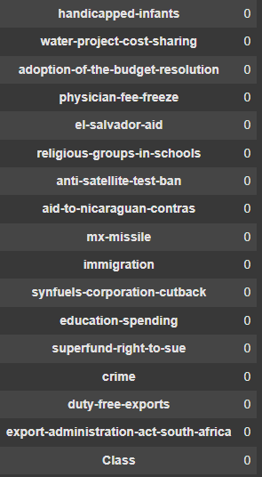
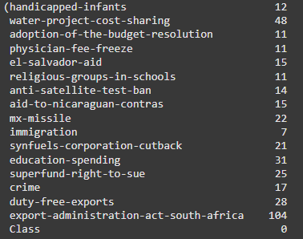
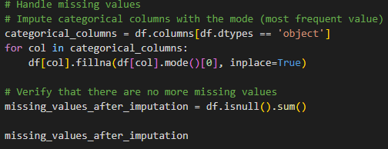
Data Preprocessing
Handling Missing values:
The dataset had missing values represented by ? In several columns
I replaced the missing values with the most frequent value in each column

Slide 7
Data Preprocessing
Encoding Categorical Data
The voting behavior is represented as categorical values Y for Yes and N for NO and ? For missing
I converted these categorical values into numerical values using Label Encoding Y → 1 and N → 0
For the class column was encoded similarly 0 → Democrats and 1 → Republican.
Train-Test Split
I divided the dataset into a training set 70% and testing set 30%
The training set was used to train the model, while the testing set was used to evaluate model performance

Slide 8
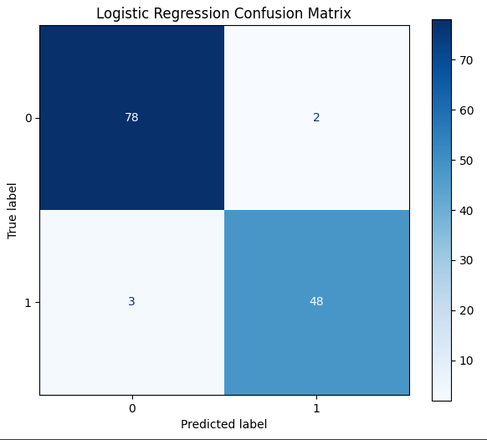
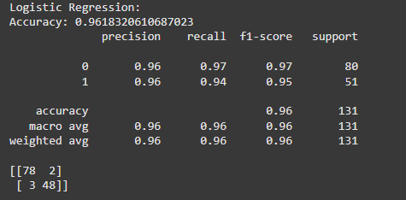
Classifiers
Logistic Regression Performance :
This classifier is ideal for this dataset as it predicts probabilities and provides clear decision boundaries between two classes (Democrat vs. Republican).
Results:
Accuracy: 96.18%
Precision For Class 0 (Democrat): 96%
Precision For Class 1 (Republican): 96%
Recall For Class 0 (Democrat): 97%
Recall For Class 1 (Republican): 94%
True Positives (TP) = 48 correct predictions for Republicans
True Negatives (TN) = 78 correct predictions for Democrats
False Positives (FP) = 2 Democrats incorrectly predicted as Republicans
False Negatives (FN) = 3 Republicans incorrectly predicted as Democrats

Slide 9

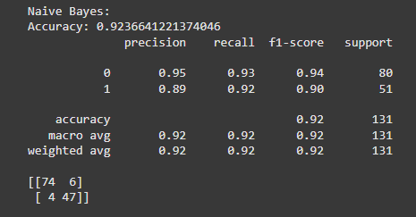
Classifiers
Naive Bayes Performance:
Naive Bayes Fast and efficient for categorical data. Naive Bayes performs well for text classification or categorical data, which is what this dataset consists of yes/no votes.
Results:
Accuracy: 92.37%
Precision For Class 0 (Democrat): 95%
Precision For Class 1 (Republican): 89%
Recall For Class 0 (Democrat): 93%
Recall For Class 1 (Republican): 92%
True Positives (TP): 47 Correct predictions for Republicans
True Negatives (TN): 74 Correct predictions for Democrats
False Positives (FP): 6 Democrats incorrectly predicted as Republicans
False Negatives (FN): 4 Republicans incorrectly predicted as Democrats

Slide 10
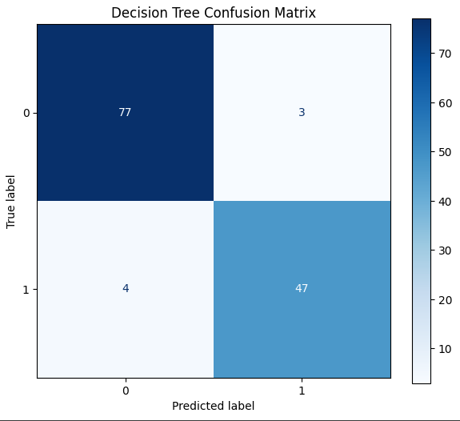
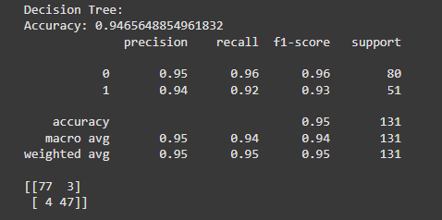
Classifiers
Decision Tree Performance:
The Decision Tree is suitable for this dataset as it can model complex, non-linear relationships between voting behavior and party affiliation.
Accuracy: 94.66%
Precision For Class 0 (Democrat): 95%
Precision For Class 1 (Republican): 94%
Recall For Class 0 (Democrat): 96%
Recall For Class 1 (Republican): 92%
True Positives (TP): 47 Correct predictions for Republicans
True Negatives (TN): 77 Correct predictions for Democrats
False Positives (FP): 3 Democrats incorrectly predicted as Republicans
False Negatives (FN): 4 Republicans incorrectly predicted as Democrats

Slide 11
Evaluation
Cross-Validation:
Cross-validation is an evaluation technique used to assess how well a machine learning model generalizes to unseen data. In k-fold cross-validation:
Logistic Regression Cross-Validation Mean Accuracy: 95.36%
Naive Bayes Cross-Validation Mean Accuracy: 90.11%
Decision Tree Cross-Validation Mean Accuracy: 93.79%

Slide 12
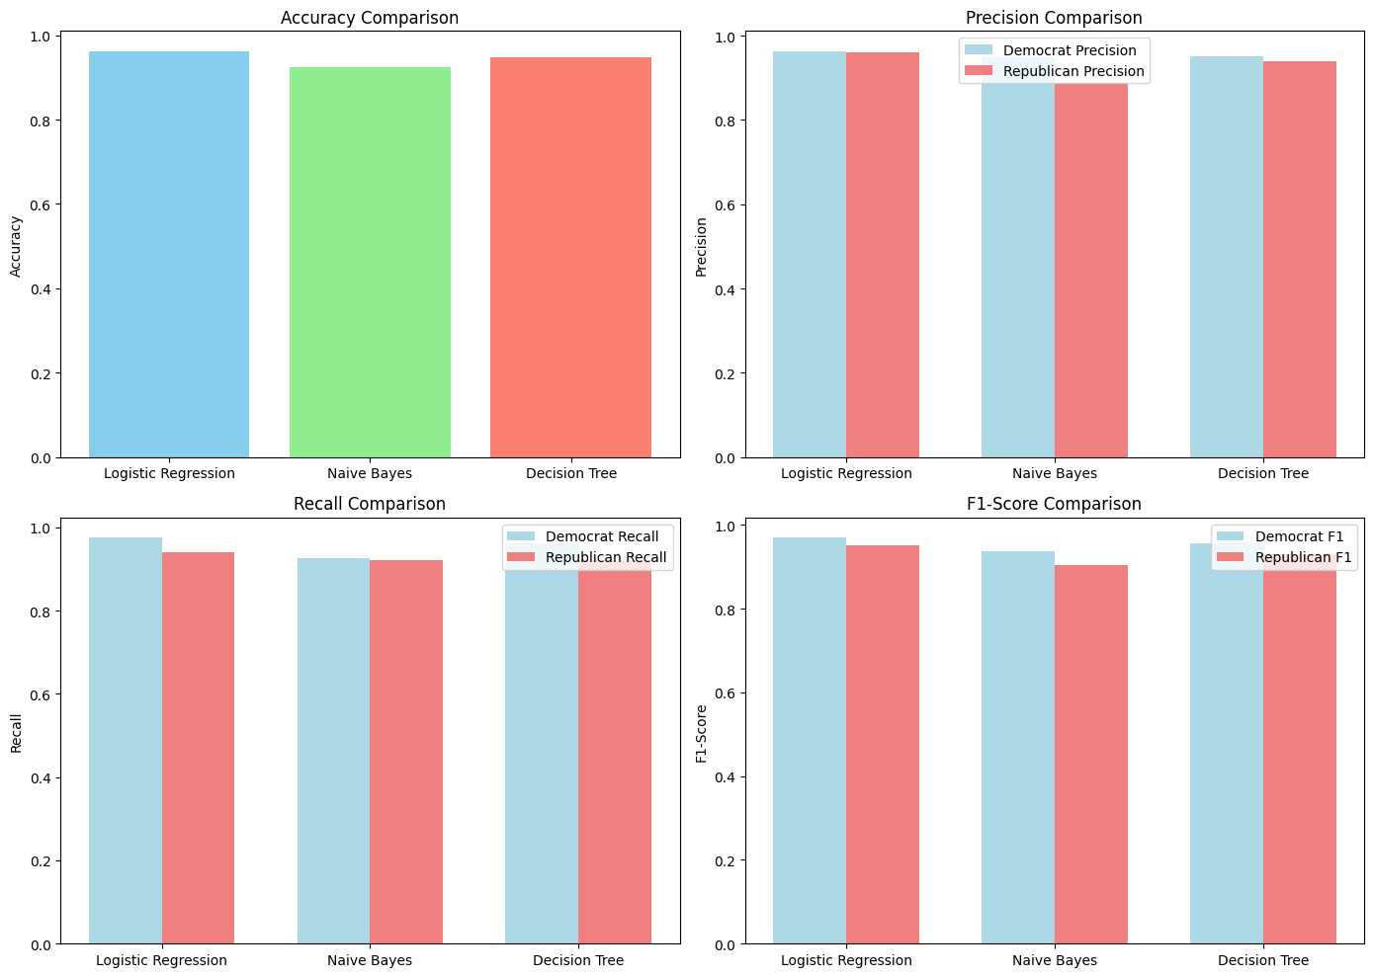
Comparison
Accuracy
Logistic Regression: 96.18%
Naive Bayes: 92.37%
Decision Tree: 94.66%
Precision
Logistic Regression:
Class 0: 96%, Class 1: 96%
Naive Bayes:
Class 0: 95%, Class 1: 89%
Decision Tree:
Class 0: 95%, Class 1: 94%
Recall
Logistic Regression:
Class 0: 97%, Class 1: 94%
Naive Bayes:
Class 0: 93%, Class 1: 92%
Decision Tree:
Class 0: 96%, Class 1: 92%
F1-Score
Logistic Regression:
Class 0: 97%, Class 1: 95%
Naive Bayes:
Class 0: 94%, Class 1: 90%
Decision Tree:
Class 0: 96%, Class 1: 93%

Slide 13
Conclusion
Best Classifier: Logistic Regression
Logistic Regression outperformed Naive Bayes and Decision Tree in terms of accuracy (96.18%) and achieved consistently high precision, recall, and F1-scores for both Democrats and Republicans.
Naive Bayes:
While simpler and faster, Naive Bayes had slightly lower accuracy (92.37%) and struggled with precision for Republicans.
Decision Tree:
Decision Tree performed well with an accuracy of 94.66% and offered valuable insights into feature importance. However, it was slightly less accurate than Logistic Regression.

Slide 14
Thank You!

